Slide 1
Inheritance

Slide 2
Introduction
permits code reusability
  saves time and money during program development
  reduce frustration and increase reliability
  encourages the use of proven and debugged high-quality software
  C++ classes can be reused in several ways
    the ease of distributing class libraries
inheritance
  mechanism of deriving a new class from an old one
  base class and derived class
  is –a relationship not has-a relationship

Slide 3
Forms of inheritance
Single inheritance
Multiple inheritance
Hierarchical inheritance
Multilevel inheritance
Hybrid inheritance

Slide 4
Defining derived classes
  class derived-class-name : visibility-mode base-class-name
  {
  …..//members of derived class
  };
  class ABC : private XYZ // default mode
  class ABC : public XYZ
  in both cases the private members are not inherited

Slide 5
Single Inheritance
class base {
private:
int a;
public:
int b;
void setAB() {a=5; b=10;}
int getA() {return a;}
};
public derivation

Slide 6
Single Inheritance cont…
class derived : public base {
private:
int c;
public:
void mul();
void show();
};
void derived : mul()
{ c=getA()*b; }

Slide 7
Single Inheritance cont…
void derived : show()
{
cout << getA() << b << c;
}
void main()
{
derived d;
d.setAB();
d.mul();
d.show();
}

Slide 8
Single Inheritance cont…
private derivation
class derived : private base {
private:
int c;
public:
void mul();
void show();
};
void derived : mul()
{ setAB(); c=getA()*b; }

Slide 9
Single Inheritance cont…
void derived : show()
{
cout << getA() << b << c;
}
void main()
{
derived d;
// d.setAB(); private function
d.mul();
d.show();
}

Slide 10
Substituting base class constructor
Derived class default constructor –uses superclass default constructor
The protected Access Specifier
  Dangers of protected
Remember base class remains unchanged
  i.e it has no idea of the existence of derived classes

Slide 11
protected keyword
Base class visibility | Derived class Visibility
 | Public derivation | Private derivation
private | Not inherited | Not Inherited
protected | protected | private
public | public | private

Slide 12
protected keyword cont…
Access control to the private and protected members of a class
  A friend function of the class
  A member function of a class that is a friend of the class
  A member function of the derived class however have access only to protected data

Slide 13
Derived class constructors
The compiler will substitute a no-argument constructor from the base class but it draws a line at more complex constructors
Solution
  call the base class constructor using the initialization list
Example BoxWeight class
Counter class
CountDn class

Slide 14
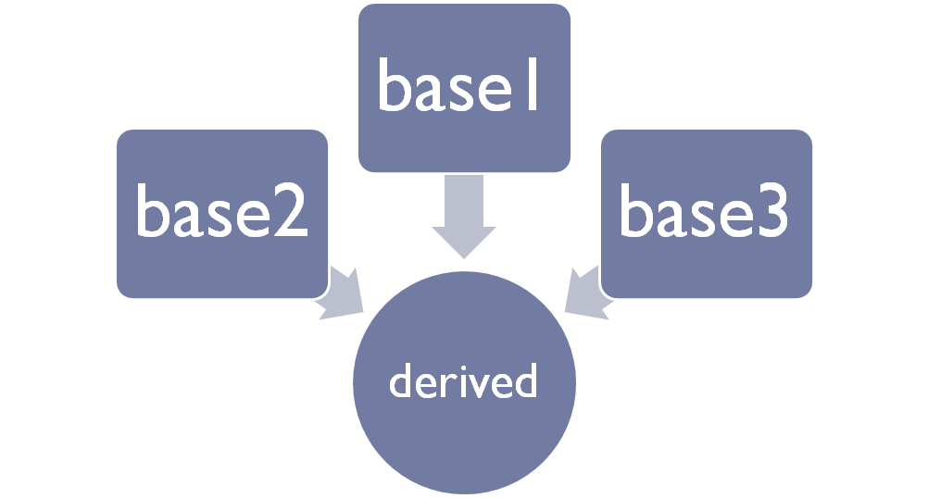
Multiple Inheritance
A class inherit the attributes of two or more classes

Slide 15
Multiple Inheritance cont…
class student{
protected:
int marks;
public:
void setMarks() {marks=100;}
};
class employee{
protected:
int salary;
public:
void setSalary() {salary=20000;}
};

Slide 16
Multiple Inheritance cont…
class Artist{
protected:
int paintings;
public:
void setPaints() {paintings=3;}
};
class CMember: public student, public employee, public Artist
{
public:
void display() { cout << marks << salary<< paintings;}
};

Slide 17
Multiple Inheritance cont…
The effect of the inheritance is as follows
class CMember{
protected:
int marks,salary,paintings; //from student, employee, Artist
public:
void setMarks(); //inherited from student
void setSalary(); // “” from employee
void setPaints(); // “” from Artist
void display(); // own member
};

Slide 18
Multiple Inheritance cont…
void main()
{
CMember d;
d.setMarks();
d.setSalary();
d.setPaints();
d.display();
}

Slide 19
Ambiguity in multiple inheritance
class student{
public:
void show();
};
class employee{
public:
void show();
};

Slide 20
Ambiguity in multiple inheritance cont…
class CMember : public student, public employee
{
public:
void display();
};
void main()
{
CMember obj;
obj.show();
obj.student::show();
}

Slide 21
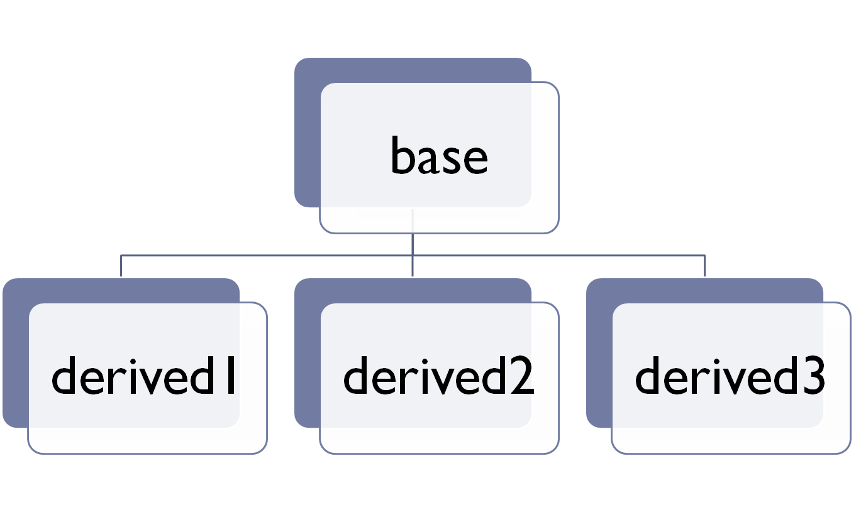
Hierarchical inheritance

Slide 22
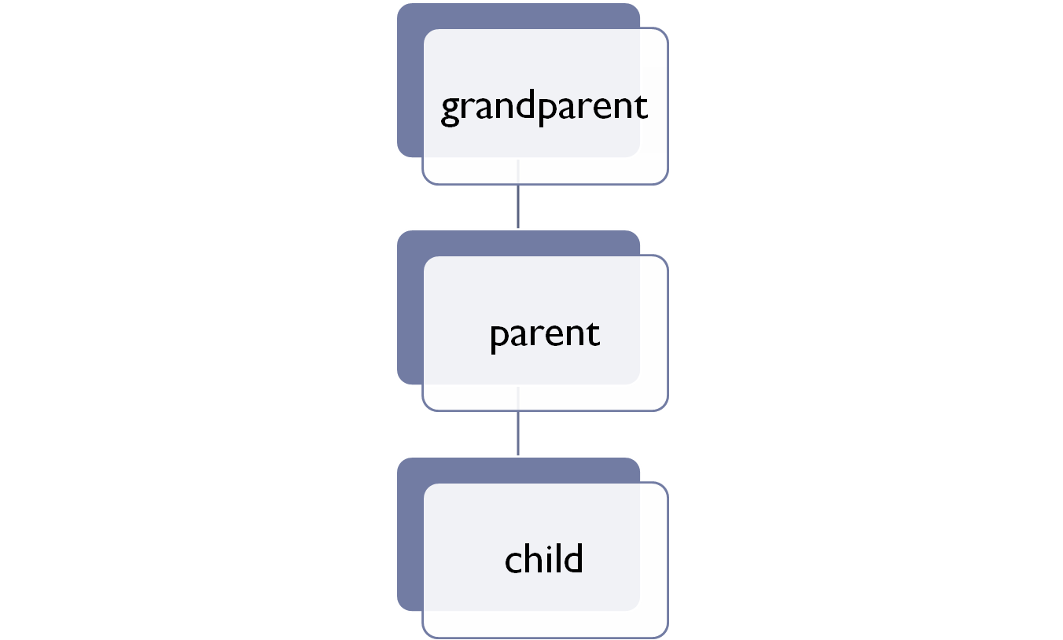
Multilevel inheritance

Slide 23
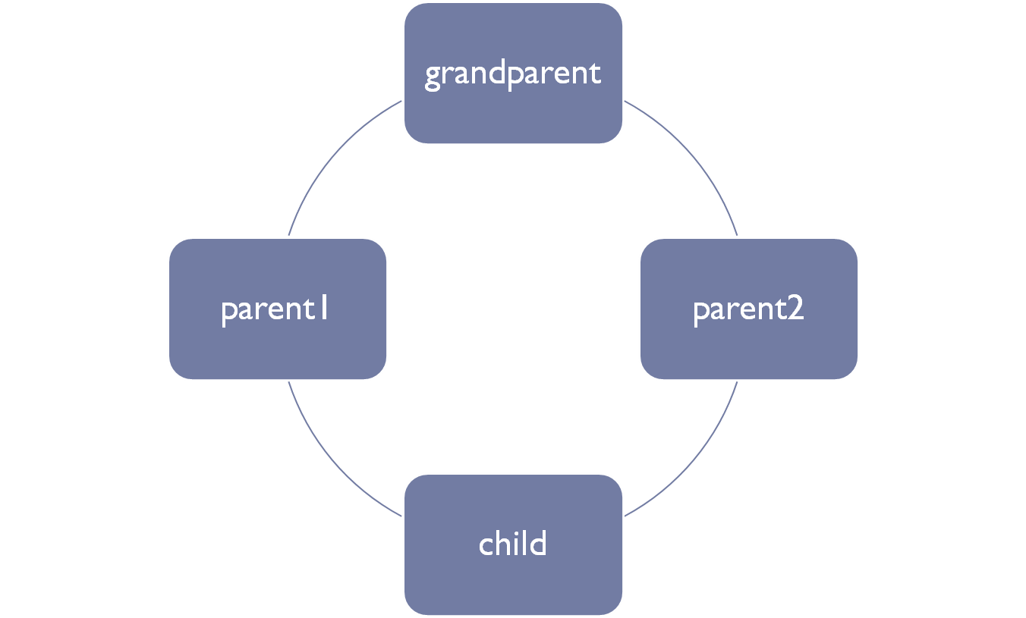
Hybrid Inheritance

Slide 24
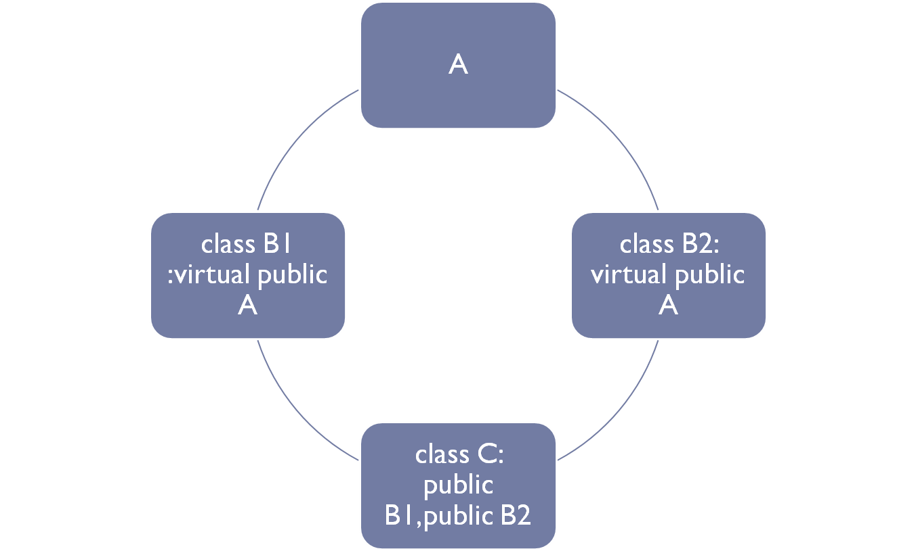
virtual base class

Slide 25
virtual base class cont…
only one copy of the class A is inherited by C
this however does not solve the ambiguity problem
class A{
public:
void show() { cout << "hello I am grandparent A";}
};
class B1: virtual public A{
};
class B2: virtual public A{
};

Slide 26
virtual base class cont…
class C :public B1, public B2
{
public:
void display() { cout << " i am C" ; }
};
void main()
{
clrscr();
C obj;
obj.show();
}

Slide 27
overriding member functions
you can use member functions in a derived class that override(i.e have the same name) as those in the base class
class Stack{
protected:
enum {MAX=3};
int st[MAX];
int top;
public:
Stack() { top=-1;}

Slide 28
overriding member functions cont…
void push(int var)
{
st[++top]=var;
}
int pop()
{
return st[top--];
}
};

Slide 29
overriding member functions cont…
class Stack2 :public Stack
{
public:
void push(int var)
{
if (top>=MAX-1)
{
cout << “Stack full “;
exit(1);
}
Stack::push(var);
}

Slide 30
overriding member functions cont…
int pop()
{
if (top<0)
{
cout << “Stack empty “;
exit(1);
}
return Stack::pop();
}
};

Slide 31
overriding member functions cont…
void main()
{
Stack2 st;
st.push(12);
st.push(22);
st.push(33);
cout << st.pop();
}
scope resolution with overridden functions
  otherwise it is recursive

Slide 32
Overloading restrictions
An overloaded member function in the derived class hides all inherited member functions of the same name (E.g Hide.cpp)

Slide 33
constructors in derived classes
as long as no base class constructor takes any arguments, the derived class need not have a constructor function
if any base class contains a constructor with one or more arguments, then it is mandatory for the derived class to have a constructor and pass the arguments to the base class constructor
when both the derived and base classes contain constructors, the base constructor is executed first and then the constructor in the derived class is executed

Slide 34
constructors in derived classes cont…
multiple inheritance:
  base classes are constructed in the order in which they appear in the declaration of the derived class
multilevel inheritance
  constructors will be executed in the order of inheritance
Derived.cpp

Slide 35
Constructors in derived classes
Method of Inheritance | Order of Execution
class B: public A | A(); base constructor B(); derived constructor
class A: public B, public C | B(); base (first) C(); base (second) A(); derived
class A: public B, virtual C | C(); virtual base B(); ordinary base A(); derived

Slide 36
Nesting of classes (containership)
when a class contains other classes as members (Employee.cpp)
has-a relationship
the constructors of the member objects are called in the order in which they are declared in the nested class (i.e irrespective of what order we use in the initialization list).

